Slide 1
A Parallel Algorithm Template for Updating SSSP in Large-Scale Dynamic Networks
Hassaan Qadir(i210883)
Mustafa Irfan(i210626)
Walia Fatima(i210838)

Slide 2
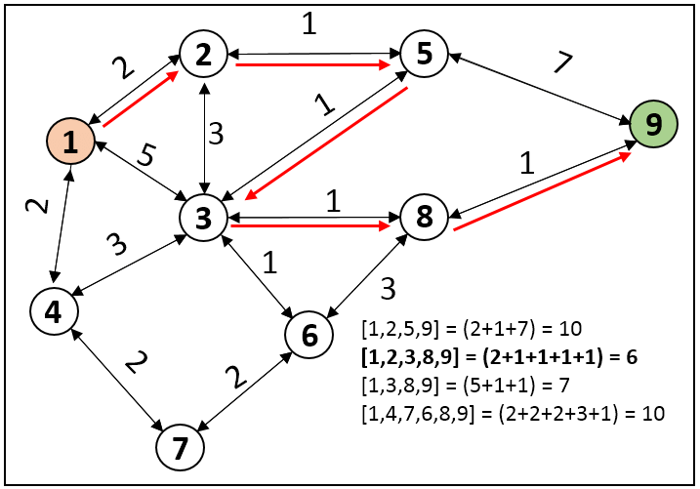
Introduction
Single-Source Shortest Path (SSSP) finds minimum distance paths from a source node to all others.
Traditional algorithms (like Dijkstra) assume static graphs.
Real-world graphs (social, transport, cyber-physical) are dynamic, meaning edges/nodes can be added or deleted.
Updating SSSP efficiently after changes is critical for scalability.

Slide 3
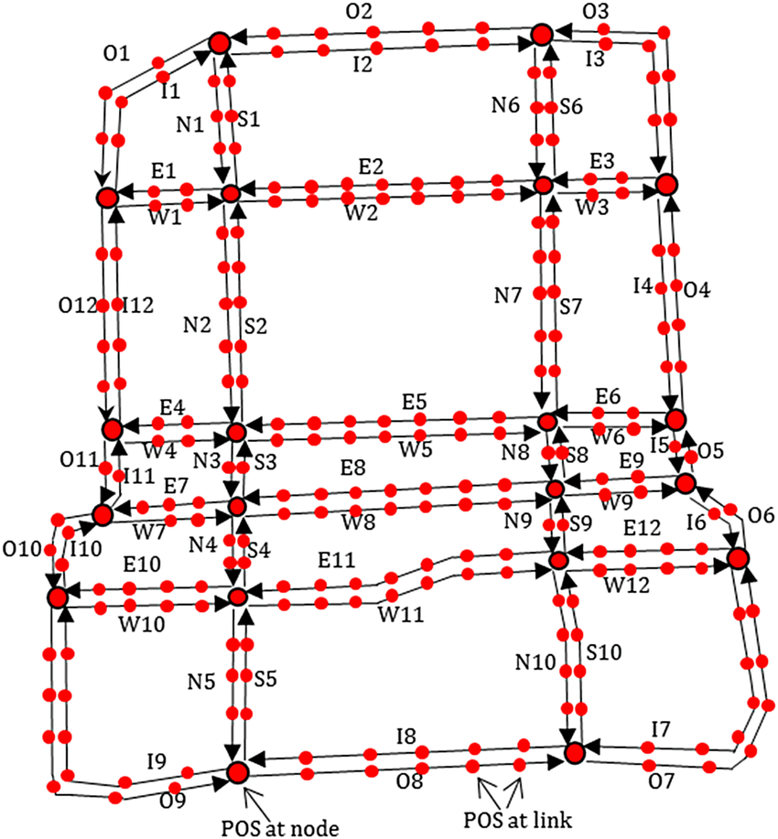
Motivation
Large-scale dynamic networks require real-time updates i.e recomputing the full SSSP tree is too slow.
Example applications: Traffic routing systems,Real-time friend suggestions in social networks.
Need a parallel algorithm that updates only the affected part of the graph, not the entire graph.

Slide 4
Proposed Parallel Framework
Identifying the affected sub-graph based on inserted or deleted edges
Updating distances only for affected nodes without re-computing SSSP for all nodes.
Supports both shared memory (multicore CPUs) and massive parallelism (GPUs).

Slide 5
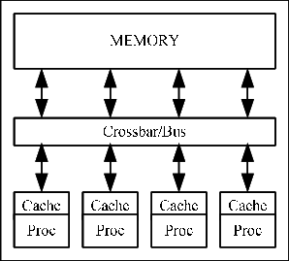
Parallelism on CPU (Shared memory)
Using OpenMP to parallelize detection of affected vertices and update operations.
Dynamic scheduling that balances the varying load of different subgraph sizes.
Asynchronous updates which reduce the need for thread synchronization.

Slide 6
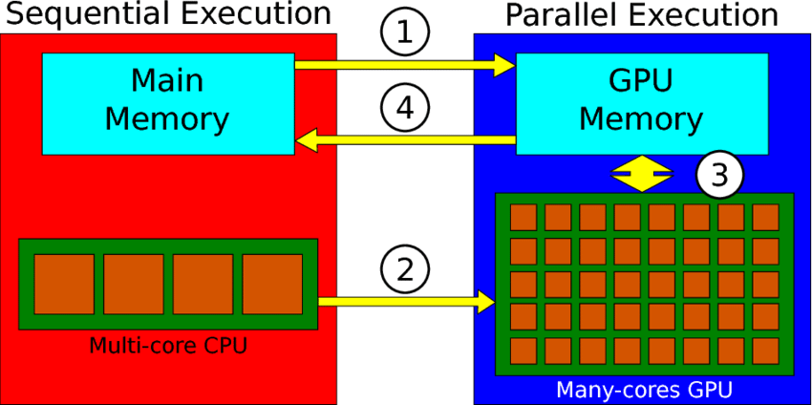
Parallelism on GPU
Used CUDA for massive parallelism.
CSR (Compressed Sparse Row) format used for efficient memory access.
Thousands of vertices and edges processed simultaneously.

Slide 7
Challenges and Solutions
Varying sub-graph sizes handled by dynamic work scheduling.
Lock-free iterative convergence approach used instead of expensive locking.
Careful handling of parent updates to prevent formation of cycles in the SSSP tree.

Slide 8
Experimental Results
GPU: Up to 8.5x speedup compared to recomputing with Gunrock.
to 5x speedup compared to Galois-based recomputation.
Faster updates when:
Less than 50% of the graph is modified.
Majority of changes are insertions rather than deletions.

Slide 9
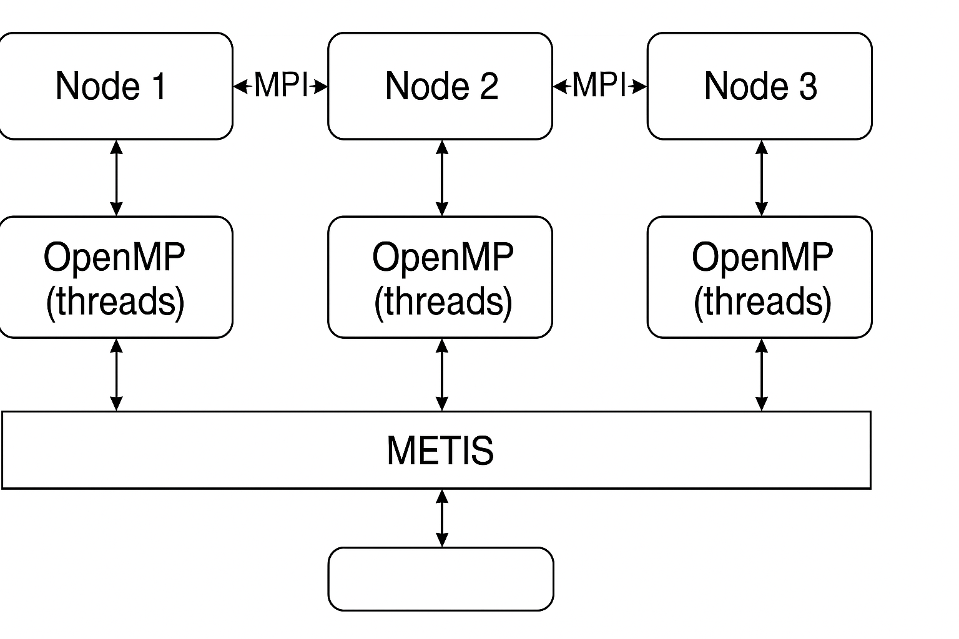
Parallelization Strategy Proposal
MPI for Inter-node Communication(Communication across servers)
OpenMP/OpenCL for Intra-node Parallelism(Local thread-level parallelism)
METIS for Graph Partitioning(Optimal Graph Positioning)
Hybrid model where MPI handles coarse-grain parallelism (across nodes), OpenMP/OpenCL handles fine-grain parallelism (within nodes).

Slide 10
Conclusion
A scalable framework for dynamic SSSP updates.
Parallel implementations for both CPU and GPU platforms.
Extended with a proposed MPI + OpenMP/OpenCL + METIS parallelization for exascale systems.

